Slide 1
You want to PaaS up your Database, Migrating to Azure SQL
Daniel Taylor

Slide 2

Daniel Taylor, Microsoft
Sr. Azure FastTrack CXP Engineer
Started as Sybase ASE / IQ DBA
SQL Server 2000 and beyond
Proud Geek, Video Gamer, and lover of the mountains
@dbabulldog
datay@microsoft.com
https://github.com/dbabulldog-repo/SharedPresentations.git

Slide 3

Azure FastTrack CXP
FastTrack for Azure Supported Solutions
We support the following hero solutions:
Datacenter migration
Windows Server on Azure
Linux on Azure
SAP on Azure
Business continuity and disaster recovery
High-performance computing
Internet of Things (IoT)
Cloud-native apps
DevOps
App modernization
Data modernization to Azure
Security
Globally distributed data
Windows Virtual Desktop
ASM Migration
Azure Management and Governance
Artificial Intelligence and Machine Learning
Analytics
aka.ms/FTA

Slide 4


Tales from the Field
Live Tuesdays & Thursdays
1 PM to 1:30 PM EST
12 PM to 12:30 PM CST
11 AM to 11:30 AM MST
10 AM to 10:30 AM PST
Wednesday – MS Tech Bits
https://www.youtube.com/@Tales-from-the-Field
Notes:
9:07

Slide 5

Our journey to Azure SQL DB / Managed Instance
Things we should consider
Choosing our target
Migration to Azure SQL DB
Migration to Azure Managed Instance (MI)
Post Migration Considerations

Slide 6
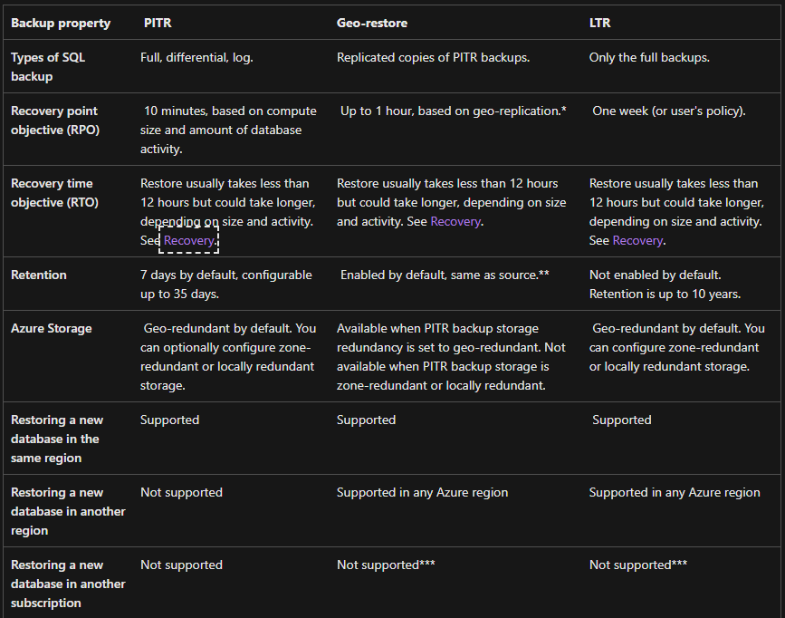
Things we should consider
Current and Expected size of Database
Performance considerations / Workload
SLA / RPO / RTO
BCDR considerations
Instance / Database dependencies
https://bit.ly/3BTTeFn
Notes:
Resource Limits:
https://learn.microsoft.com/en-us/azure/azure-sql/managed-instance/resource-limits?view=azuresql#file-io-characteristics-in-general-purpose-tier
https://learn.microsoft.com/en-us/azure/azure-sql/database/resource-limits-vcore-single-databases?view=azuresql
What is the current size of the databases?
* Azure SQL DB has size limitations based on the SKU and Tier.
* Azure SQL DB has a max size of 4 TB
* Azure Hyperscale SQL DB has a max size of 100 TB
* Azure MI has a max size of 8 or 16 TB based on its tier
* General Purpose service tier - Azure SQL Database & Azure SQL Managed Instance | Microsoft Docs - https://bit.ly/3BrhRrw
* Business Critical service tier - Azure SQL Database & Azure SQL Managed Instance | Microsoft Docs - https://bit.ly/3BrU1M9
What is the expected growth for the database?
* Determining growth is important as it helps us define which Azure SQL DB we can look at migrating to
* Refer to links provided above for max size limitations of each database and each tier
What is our workload? This can best be determined by executing the following to gather database performance data.
* Get Azure SQL SKU recommendations (Data Migration Assistant) - SQL Server | Microsoft Docs - https://bit.ly/3Uo0Tme
What is out SLA?
* What level of resilience does the database require? Will we require geo-replicated database? Will geo-redundant backups work as a DR model?
* High availability - Azure SQL Database and SQL Managed Instance | Microsoft Docs - https://bit.ly/3qQbt8e
What is the RTO/RPO of the database?
* Azure SQL DB and Managed Instance Provides point in time recovery from the local backups
* Automatic, geo-redundant backups - Azure SQL Database & Azure SQL Managed Instance | Microsoft Docs- https://bit.ly/3QYyFf0
* Note the RPO and RTO capabilities noted in section “Restore capabilities and features of Azure SQL Database and Azure SQL Managed Instance”
Is there any breaking changes found in the DMA ( Database Migration Assistant)
* Is the breaking change in Azure SQL DB can we utilize Azure Managed Instance?
* What will it take to fix the identified breaking change?
Does the database require HA? What is the BCDR plan for the database in question?
High availability - Azure SQL Database and SQL Managed Instance | Microsoft Docs - https://bit.ly/3RVzoz7
Does the database have a reliance on another database within the SQL Server Instance? Does the database/application have a query that spans multiple databases with a single connection?
Is there a reliance on linked servers?
Does the database require SQL Agent jobs outside of scheduled maintenance?
* One possible solution to SQL Agents
* Managed Instances have the ability to deploy SQL Agent Jobs
Does the database require the OS?
* For example are there Stored Procs that make calls to the OS

Slide 7
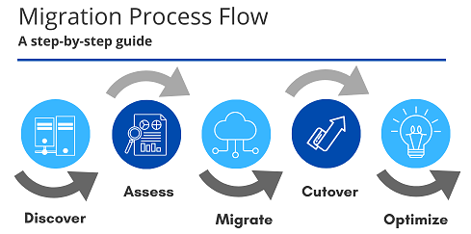
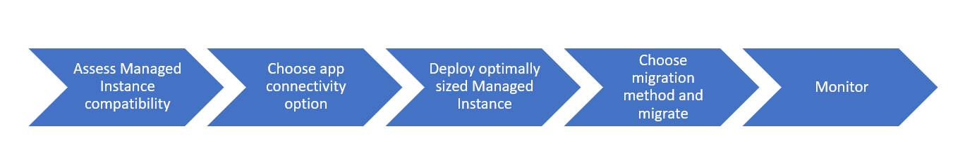
Choosing our target
Azure SQL DB or Managed Instance
Considerations from the previous slide
SKU recommendation
Notes:
What is the current size of the databases?
* Azure SQL DB has size limitations based on the SKU and Tier.
* Azure SQL DB has a max size of 4 TB
* Azure Hyperscale SQL DB has a max size of 100 TB
* Azure MI has a max size of 8 or 16 TB based on its tier
* General Purpose service tier - Azure SQL Database & Azure SQL Managed Instance | Microsoft Docs - https://bit.ly/3BrhRrw
* Business Critical service tier - Azure SQL Database & Azure SQL Managed Instance | Microsoft Docs - https://bit.ly/3BrU1M9
What is the expected growth for the database?
* Determining growth is important as it helps us define which Azure SQL DB we can look at migrating to
* Refer to links provided above for max size limitations of each database and each tier
What is our workload? This can best be determined by executing the following to gather database performance data.
* Get Azure SQL SKU recommendations (Data Migration Assistant) - SQL Server | Microsoft Docs - https://bit.ly/3Uo0Tme
What is out SLA?
* What level of resilience does the database require? Will we require geo-replicated database? Will geo-redundant backups work as a DR model?
* High availability - Azure SQL Database and SQL Managed Instance | Microsoft Docs - https://bit.ly/3qQbt8e
What is the RTO/RPO of the database?
* Azure SQL DB and Managed Instance Provides point in time recovery from the local backups
* Automatic, geo-redundant backups - Azure SQL Database & Azure SQL Managed Instance | Microsoft Docs- https://bit.ly/3QYyFf0
* Note the RPO and RTO capabilities noted in section “Restore capabilities and features of Azure SQL Database and Azure SQL Managed Instance”
Is there any breaking changes found in the DMA ( Database Migration Assistant)
* Is the breaking change in Azure SQL DB can we utilize Azure Managed Instance?
* What will it take to fix the identified breaking change?
Does the database require HA? What is the BCDR plan for the database in question?
High availability - Azure SQL Database and SQL Managed Instance | Microsoft Docs - https://bit.ly/3RVzoz7
Does the database have a reliance on another database within the SQL Server Instance? Does the database/application have a query that spans multiple databases with a single connection?
Is there a reliance on linked servers?
Does the database require SQL Agent jobs outside of scheduled maintenance?
* One possible solution to SQL Agents
* Managed Instances have the ability to deploy SQL Agent Jobs
Does the database require the OS?
* For example are there Stored Procs that make calls to the OS

Slide 8
Tools to help choose our target
Tools available to help evaluate and determine our target
Azure Data Studio
Evaluate breaking changes, compatibility, and SKU recommendations
Can be used to migrate database(s) to Azure SQL MI, Azure Virtual Machines
Data Migration Assistant
Evaluate breaking changes, compatibility, and SKU recommendations
Can be used to migrate database(s) to Azure SQL DB

Slide 9
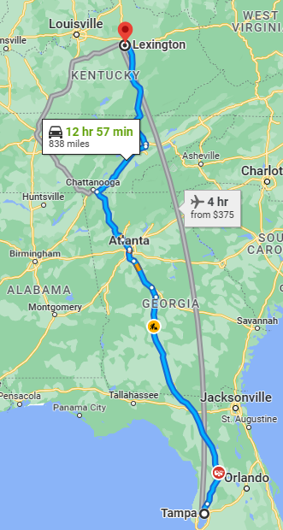
Migration to Azure SQL DB
SQLPackage
Bacpac / dacpac + Bulk Copy Protocol (BCP)
Smart Bulk Copy Tool
Data Migration Assistant (DMA)
Azure Data Studio with Azure SQL Migration Extension (Preview)
SQL Server Replication
Notes:
.bacpac
.dacpac + Bulk Copy Protocol (BCP)
Smart Bulk Copy Tool
https://github.com/Azure-Samples/smartbulkcopy
Data Migration Assistant (DMA)
Azure SQL Server replication to Azure SQL Database - Azure SQL Database | Microsoft Docs

Slide 10
Migration to Azure SQL DB
SQLPackage
Command-line utility which exposes DacFX APIs
Export and Import of the package
Export includes data and schema
Ensures Azure SQL Database compatibility
SQL Server and Database must be created before migration
# example export connecting using Azure Active Directory universal authentication SqlPackage /Action:Export /TargetFile:"C:\AdventureWorksLT.bacpac" /UniversalAuthentication=True \ /SourceConnectionString:"Server=tcp:{yourserver}.database.windows.net,1433;Initial Catalog=AdventureWorksLT;MultipleActiveResultSets=False;Encrypt=True;TrustServerCertificate=False;Connection Timeout=30;"
# example import connecting using Azure Active Directory universal authentication SqlPackage /Action:Import /SourceFile:"C:\AdventureWorksLT.bacpac" /UniversalAuthentication=True \ /TargetConnectionString:"Server=tcp:{yourserver}.database.windows.net,1433;Initial Catalog=AdventureWorksLT;MultipleActiveResultSets=False;Encrypt=True;TrustServerCertificate=False;Connection Timeout=30;"

Slide 11
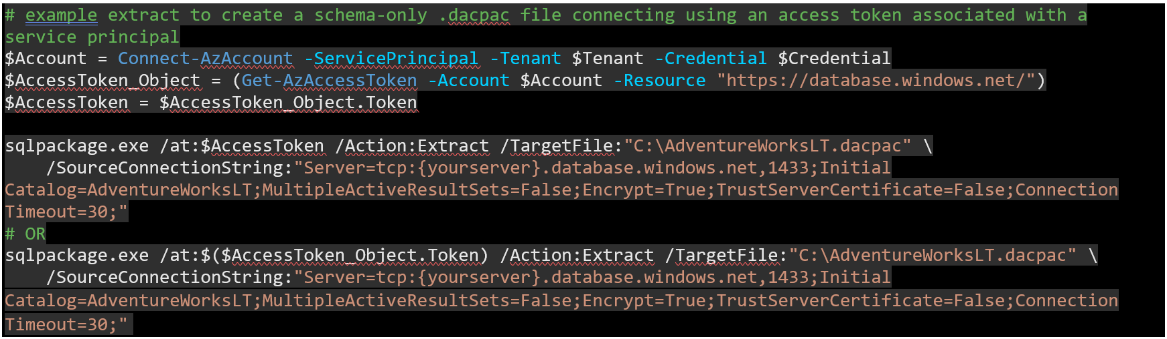
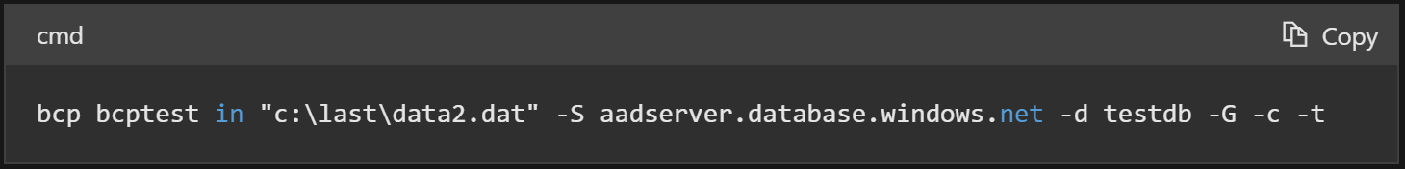
Migration to Azure SQL DB
BACPAC / DACPAC + Bulk Copy Protocol (BCP)
BACPAC captures schema and data
DACPAC for development, deployment, & management of data-tier elements
SQLPackage, SQL Server Management Studio, & Azure Data Studio
SQL Server and Database must be created before migration

Slide 12
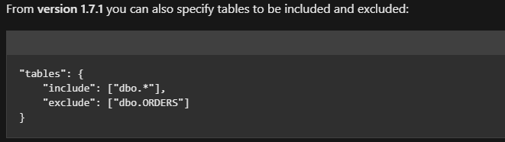
Migration to Azure SQL DB
Smart Bulk Copy Tool
Utilizes Bulk Copy API with parallel tasks
Utilizes your partition on source tables
If no physical partition will logically partition
Allows flexibility with what tables to include/exclude ( 2 Part names, Schema, *)
Highly configurable (smartbulkcopy.config)
Parallelism, Partitions, Batch Size
Table Truncation, Identity Sync, Safety Checks
Connection resiliency, Connection timeout
SQL Server and Database must be created before migration
Notes:
Parallel Tasks
When a source table is partitioned, it uses the physical partitions to execute several queries like the following
SELECT * FROM <sourceTable> WHERE $partition.<partitionFunction>(<partitionColumn>) = <n>
Not partitioned, then Smart Bulk Copy will use the %%PhysLoc%% virtual column to logically partition tables into non-overlapping partitions that can be safely read in parallel
SELECT * FROM <sourceTable> WHERE ABS(CAST(%%PhysLoc%% AS BIGINT)) % <logical-partitions-count> = <n>
Parallelism
"tasks": 7
Define how many parallel task will move data from source to destination. Smart Bulk Copy uses a Concurrent Queue behind the scenes that is filled will all the partition that must be copied. Then as many as tasks are created and each of Physio those will dequeue work as fast as possible. How many task you want or can have depends on how much network bandwidth you have and how much resources are available in the destination. Maximum value is 32.
Partitions
"logical-partitions": "auto"
In case a table is not physically partitioned, this option is used to create the logical partitions as described before. As a general rule at least the same amount of tasks is recommended in order to maximize throughput, but you need to tune it depending on how big your table is and how fast your destination server can do the bulk load. There are three values supported by logical-partitions:
"auto": will try to automatically set the correct number of logical partitions per table, taking into account both row count and table size
"8gb": a string with a number followed by gb will be interpreted as the maximum size, in GB, that you want the logical partitions to be. Usually big partitions size (up to 8gb) provides better throughput, but with unreliable network connections remember that in case of transaction failure, the entire partition needs be reloaded
7: a number will be interpreted as the number of logical partition you want to create.
"batch-size": 100000
"truncate-tables": true
Safety Checks
"safe-check": "readonly"
Check that source database is actually a database snapshot or that database is set to readonly mode. Using one of the two options is recommended to avoid data modification while copy is in progress as this can lead to inconsistencies. Supported values are readonly and snapshot. If you want to disable the safety check use none: disabling the security check is not recommended.
"stop-if": {"secondary-indexes": true, "temporal-table": true}
Connection Resiliency
"retry-connection": {"delay-increment": 10, "max-attempt": 5}
Defines how many times an operation should be attempted if a disconnection is detected and how much time (in seconds) should pass between two retries. Delay is incremented by delay-incremement every time a new attempt is tried.
Command Timeout
"command-timeout": 5400
Introduced in version 1.9.4 allows to set the timeout, in seconds, for a command before an error is generated. Default is set to 90 minutes (as some operations, like re-enabling Temporal Tables, if data size is big, can take quite a long time.)

Slide 13
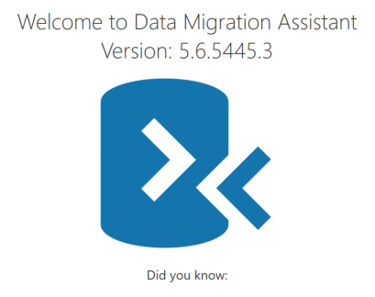
Migration to Azure SQL DB
Data Migration Assistant (DMA)
Can be used for migrating to Azure SQL DB ( Managed Instance?, SQL Server Instance? )
Can be used to evaluate the database for migration
Evaluated database can be migrated using DMA
SQL Server and Database must be created before migration
Only one database & migration can be done at a time (DMS?)
Do not directly install DMA on database server
.\SqlAssessment.exe PerfDataCollection
--sqlConnectionStrings "Data Source=Server1;Initial Catalog=master;Integrated Security=True;" "Data Source=Server2;Initial Catalog=master;Integrated Security=True;"
--outputFolder C:\Output
.\SqlAssessment.exe GetSkuRecommendation
--outputFolder C:\Output --targetPlatform AzureSqlDatabase
Notes:
https://techcommunity.microsoft.com/t5/microsoft-data-migration-blog/using-data-migration-assistant-to-assess-an-application-s-data/ba-p/990430
https://learn.microsoft.com/en-us/sql/dma/dma-assesssqlonprem?view=sql-server-ver15#add-databases-and-extended-events-trace-to-assess
https://learn.microsoft.com/en-us/sql/dma/dma-sku--sql-db?view=sql-server-ver16
It is recommended that the tool is utilized from a separate tools (client) machine with connectivity to the target SQL instance(s), rather than from the machine hosting SQL Server itself, in order to minimize any potential overhead. When collecting performance data for SKU recommendations, it is recommended that the tool is ran with default option values over the span of several hours, covering both off-peak and on-peak workloads and excluding maintenance tasks such as index rebuild or backup database. Maintenance tasks can impact the CPU, Memory and IO consumption and subsequently drive higher recommended SKU tiers.
https://learn.microsoft.com/en-us/azure/dms/tutorial-sql-server-to-azure-sql

Slide 14
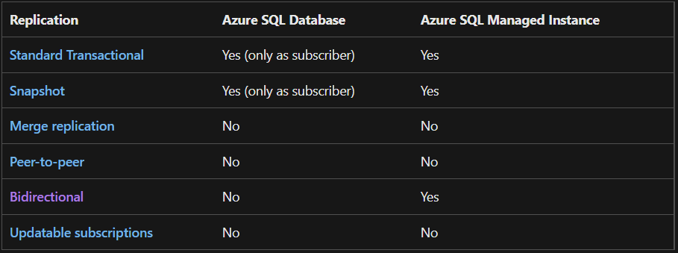
Migration to Azure SQL DB
SQL Server Replication
Azure SQL Database can only be subscriber
Instance acting as publisher/distributor
SQL Server on-premises
Azure SQL Managed Instance
SQL Server on Azure Virtual Machine
SQL Server 2012 or 2014?
Snapshot and Transaction replication supported
Must use SQL Server authentication
SQL Server and Database must be created before migration
Management, monitoring, and troubleshooting (Publisher)
Online option with minimal downtime
Notes:
SQL Server 2016 and greater
SQL Server 2014 RTM CU10 (12.0.4427.24) or SP1 CU3 (12.0.2556.4)
SQL Server 2012 SP2 CU8 (11.0.5634.1) or SP3 (11.0.6020.0)

Slide 15
Migration to Azure Managed Instance (MI)
Backup and restore
Azure Data Studio with Azure SQL Migration Extension
Log Replay Service (LRS)
Managed Instance Link
Notes:
Backup and restore - https://bit.ly/3BtPAQS
RESTORE (Transact-SQL) - SQL Server | Microsoft Docs - https://bit.ly/3xzWyCM
Back up to URL best practices & troubleshooting for Microsoft Azure Blob Storage - SQL Server | Microsoft Docs - https://bit.ly/3BMprgD
Backing up a VLDB to Azure Blob Storage | Microsoft Docs - https://bit.ly/3qOL4Yp
Azure Data Studio with Azure SQL Migration Extension - https://bit.ly/3SgHguM
https://docs.microsoft.com/en-us/azure/dms/ads-sku-recommend - https://bit.ly/3dow00B
Tutorial: Migrate SQL Server to Azure SQL Managed Instance online using Azure Data Studio - Azure Database Migration Service(DMS) | Microsoft Docs - https://bit.ly/3UmZEnl
Quickstart: Restore a backup (SSMS) - Azure SQL Managed Instance | Microsoft Docs - https://bit.ly/3S17hyn
Custom roles: Online SQL Server to SQL Managed Instance migrations using ADS - Azure Database Migration Service | Microsoft Docs - https://bit.ly/3UoNhHq
https://docs.microsoft.com/en-us/azure/dms/migration-dms-powershell-cli - https://bit.ly/3DxffuN
Log Replay Service (LRS) - https://bit.ly/3xCBCuZ
Managed Instance Link (Preview) - https://bit.ly/3SeHy5d

Slide 16
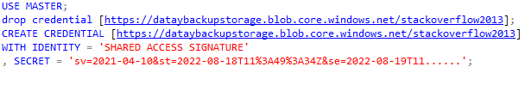
Migration to Azure Managed Instance (MI)
Backup and restore
Backup to URL or Migrate Backup file(s) to blob storage
Restore the database via familiar T-SQL commands
Can only restore a full backup when using T-SQL
Notes:
Backup and restore - https://bit.ly/3BtPAQS
RESTORE (Transact-SQL) - SQL Server | Microsoft Docs - https://bit.ly/3xzWyCM
Back up to URL best practices & troubleshooting for Microsoft Azure Blob Storage - SQL Server | Microsoft Docs - https://bit.ly/3BMprgD
Backing up a VLDB to Azure Blob Storage | Microsoft Docs - https://bit.ly/3qOL4Yp

Slide 17
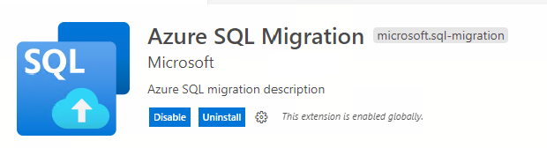
Migration to Azure Managed Instance (MI)
Azure Data Studio with Azure SQL Migration Extension
Migrate to Azure Managed Instance or SQL Server on Azure Virtual Machine
Step by step wizard: Assessment, Recommendation, Migration
Online and Offline
Powered by Data Migration Service
Leverage self hosted integration runtime to source SQL Server backups on-premises
Automate with PowerShell or Azure CLI (Preview)
Notes:
Azure Data Studio with Azure SQL Migration Extension - https://bit.ly/3SgHguM
https://docs.microsoft.com/en-us/azure/dms/ads-sku-recommend - https://bit.ly/3dow00B
Tutorial: Migrate SQL Server to Azure SQL Managed Instance online using Azure Data Studio - Azure Database Migration Service(DMS) | Microsoft Docs - https://bit.ly/3UmZEnl
Quickstart: Restore a backup (SSMS) - Azure SQL Managed Instance | Microsoft Docs - https://bit.ly/3S17hyn
Custom roles: Online SQL Server to SQL Managed Instance migrations using ADS - Azure Database Migration Service | Microsoft Docs - https://bit.ly/3UoNhHq
https://docs.microsoft.com/en-us/azure/dms/migration-dms-powershell-cli - https://bit.ly/3DxffuN

Slide 18
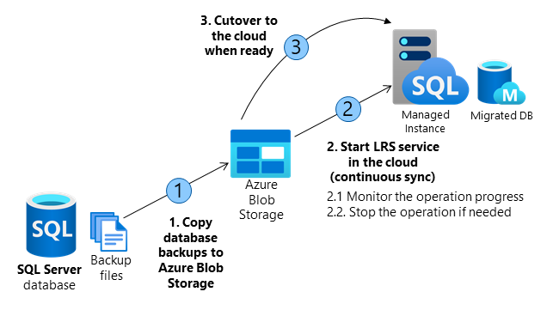
Migration to Azure Managed Instance (MI)
Log Replay Service (LRS)
Each LRS instance is for 1 database
You can have up to 100 LRS sessions active on a Managed Instance at a time LRS accepts Full Backups, Differential Backups, and Log Backups
2 ways to setup LRS
Autocomplete ( once LRS begins no new backups can be added )
Continuous mode is essentially log shipping
No GUI currently to setup
Notes:
Log Replay Service (LRS) - https://bit.ly/3xCBCuZ
You need more control for your database migration project.
There's little tolerance for downtime during migration cutover.
The Database Migration Service executable file can't be installed to your environment.
The Database Migration Service executable file doesn't have file access to your database backups.
No access to the host OS is available, or there are no administrator privileges.
You can't open network ports from your environment to Azure.
Network throttling, or proxy blocking issues exist in your environment.
Backups are stored directly to Azure Blob Storage through the TO URL option.
You need to use differential backups.

Slide 19
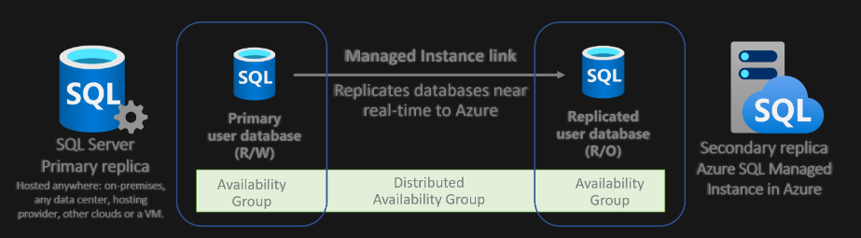
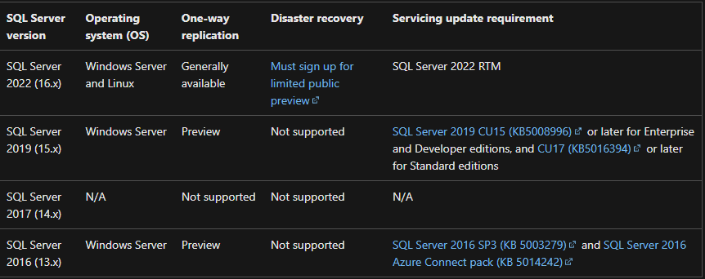
Migration to Azure Managed Instance (MI)
Managed Instance Link (Preview for some solutions)
Connects SQL Servers hosted anywhere to SQL Managed Instance
Minimal downtime migration
True online migration to any Managed Instance service tier
Understand limitations
Notes:
Managed Instance Link - https://bit.ly/3SeHy5d
Understand limitations
One-way replication (SQL Server versions 2016 to 2019):
Disaster recovery (SQL Server 2022)
Auto-failover groups aren't supported with instances that use the link feature

Slide 20
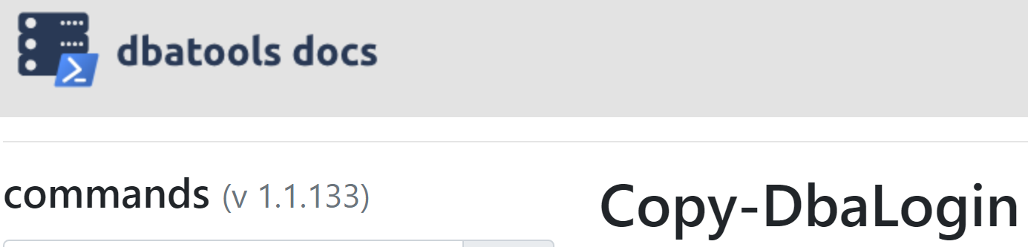
Post Migration Considerations
Logins, Agent Jobs, Maintenance ( Migration DBATools )
Performance considerations
Resiliency / BCDR needs met
Monitoring in place
SQL Insights
Azure Monitor (Managed Instance and SQL DB)
Notes:
MI
SQL Server to Azure SQL Managed Instance: Performance baseline - Azure SQL Managed Instance | Microsoft Docs - https://bit.ly/3BUzKjY
https://docs.microsoft.com/en-us/azure/azure-sql/migration-guides/managed-instance/sql-server-to-managed-instance-guide?view=azuresql#post-migration - https://bit.ly/3dp1xQ6
Microsoft Defender for SQL - Azure SQL Database | Microsoft Docs - https://bit.ly/3qOdim4
https://docs.microsoft.com/en-us/azure/azure-sql/database/monitor-tune-overview?view=azuresql - https://bit.ly/3xBdWHz
The best practices for performance comparison between Azure SQL Managed Instance and SQL Server - https://bit.ly/3dv3dri
Key causes of performance differences between SQL managed instance and SQL Server | Azure Blog and Updates | Microsoft Azure - https://bit.ly/3BwPnfI
Storage performance best practices and considerations for Azure SQL DB Managed Instance (General Purpose) - Microsoft Tech Community
Resource limits - Azure SQL Managed Instance | Microsoft Learn - https://bit.ly/3C79J0A
Azure SQL DB
https://docs.microsoft.com/en-us/azure/azure-sql/migration-guides/database/sql-server-to-sql-database-guide?view=azuresql#post-migration - https://bit.ly/3DyUqPC

Slide 21

Where did our journey take us?
Things we should consider
Choosing our target
Migration to Azure SQL DB
Migration to Azure Managed Instance (MI)
Post Migration Considerations

Slide 22
Tales from the Field
Live Tuesdays & Thursdays
1 PM to 1:30 PM EST
12 PM to 12:30 PM CST
11 AM to 11:30 AM MST
10 AM to 10:30 AM PST
Wednesday – MS Tech Bits
https://www.youtube.com/@Tales-from-the-Field
Notes:
9:07

Slide 23
Azure FastTrack CXP
FastTrack for Azure Supported Solutions
We support the following hero solutions:
Datacenter migration
Windows Server on Azure
Linux on Azure
SAP on Azure
Business continuity and disaster recovery
High-performance computing
Internet of Things (IoT)
Cloud-native apps
DevOps
App modernization
Data modernization to Azure
Security
Globally distributed data
Windows Virtual Desktop
ASM Migration
Azure Management and Governance
Artificial Intelligence and Machine Learning
Analytics
aka.ms/FTA

Slide 24
Questions ?
Thank You!

